Slide 1

Data Analytics, Data Governance & Research
Andrea Freire
Digital Transformation Leader

Slide 2
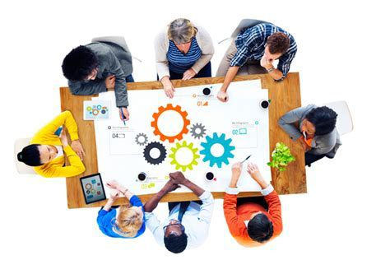
Data Analytics
Andrea Freire
Digital Transformation Leader
Data tool solutions break down
Areas of Focus:
Experiment Design & Testing
Data Science Applications
Business Insights (BI) and Reporting
Data Architecture,
Management and Governance
Digital User Experience
Measure and Testing
A/B Testing
Barriers
Data Democratization
Recap & Sugestions
Data Analysts & Scientists
BI Analyst
ITO - Infrastructure
Research
BI & Reporting
Data Governance

Slide 3
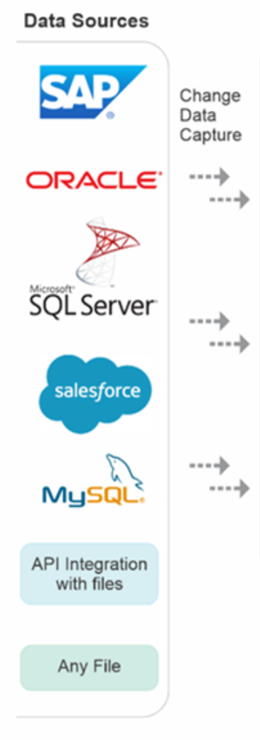
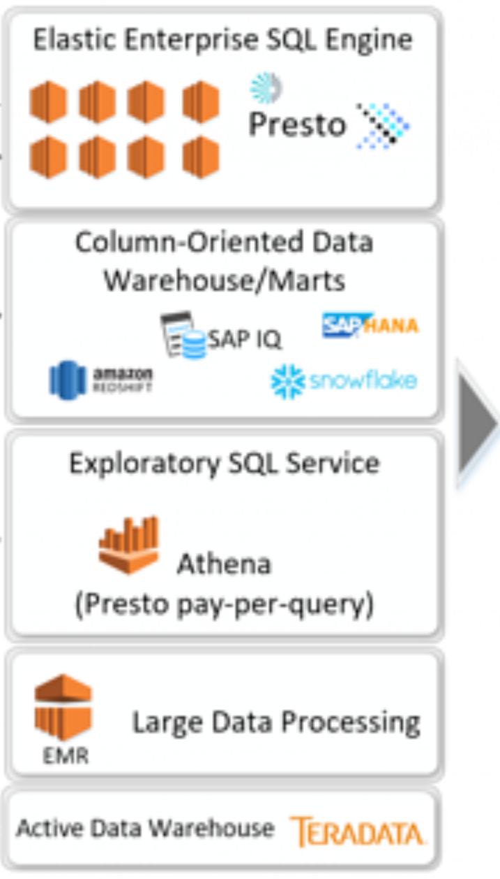
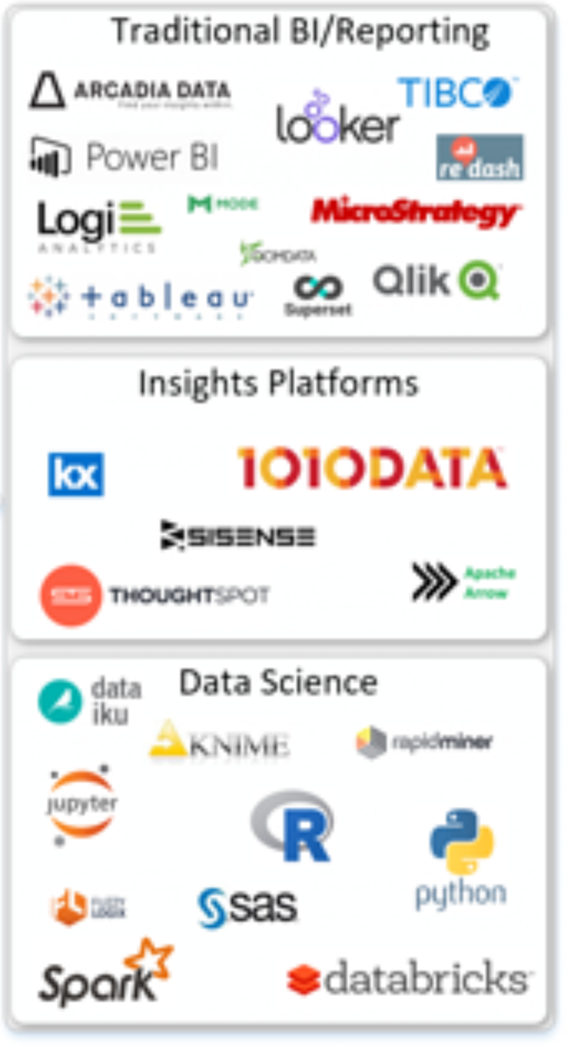
Data tools
Andrea Freire
Digital Transformation Leader
Ingest
Store, Process, [Analyze(ML)]
Analyze - Visualize

Slide 4
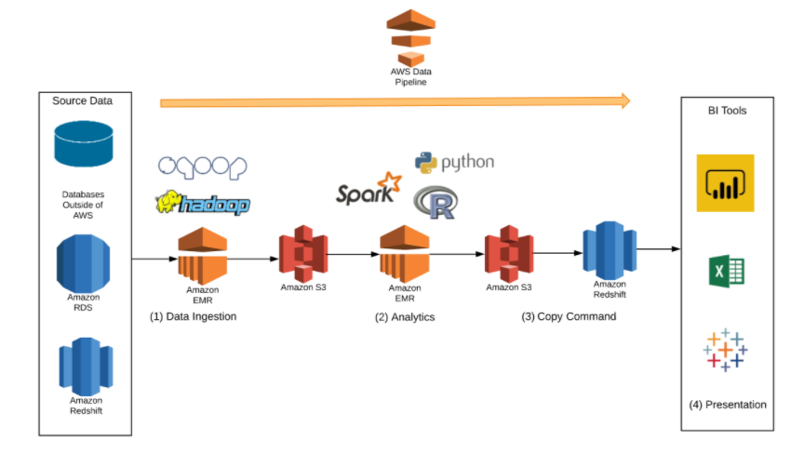
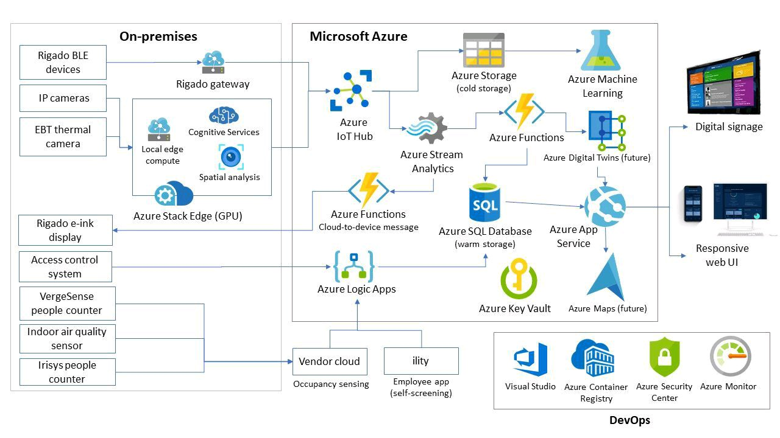
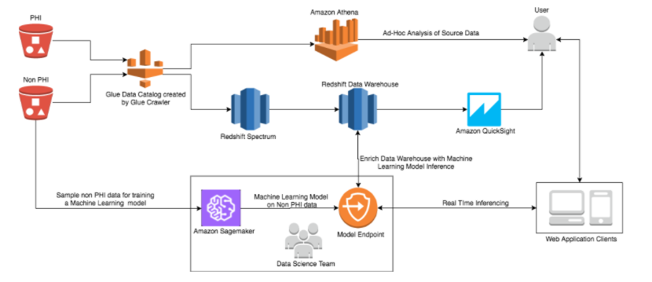
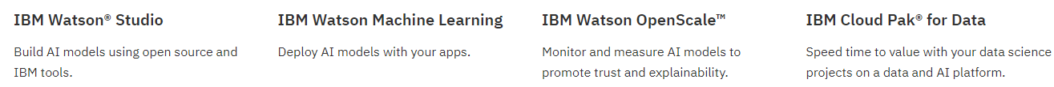
Data tools
Andrea Freire
Digital Transformation Leader
REDSHIFT
AZURE
IBM

Slide 5
Data Analytics - Areas of Focus
Andrea Freire
Digital Transformation Leader
Experiment Design & Testing
Experimentation in data science projects to cultivate more detail understanding of preferences and behaviors for users.
Experimentation learning across different parts of the organization to then facilitate effective learning to business users and executives from data insights.
Experimentation is critical to discover where a data science project would fit and how it could be woven into business unit practices.

Slide 6
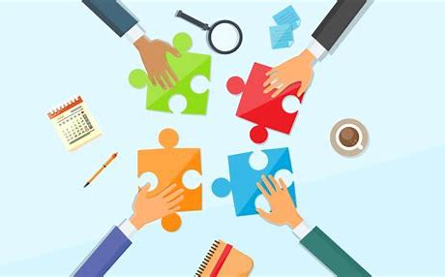
Data Analytics - Areas of Focus
Andrea Freire
Digital Transformation Leader
Data Science Applications
Establish open relationships (Analytics, Business, Administrative, Operations, IT, Other)
Identify questions such as:
Where are the opportunities to deploy data science for the biggest impact?
What questions business units and functional areas have?
Could these questions be answered with data? If so, how?
Bring data science to business units
Each unit supports experts from different capabilities groups.
Each data scientist can sit with business units’ teams and contribute to managers’ decision-making discussions.

Slide 7
Data Analytics - Areas of Focus
Andrea Freire
Digital Transformation Leader
Business Insights (BI) and Reporting
Current tools
Improve access to the full breath (non-sensitive data) of data on daily basis.
BI analysts and executives to inform what strategies to pursue.
BI analysts should understand how data is collected, processed, analyzed and reported to support executive decision making.
For visualizing data, designing reports for use by BI analysts and executives, build [new] infrastructure to deliver these visualizations.
Design the organization [create a data culture] to effectively produce, deliver, and use [new] visualization system.
Current Tools
Full Data Access
Strategies to Pursue
Understand Process of data
Infrastructure
Data Culture

Slide 8
Data Analytics - Areas of Focus
Size of data
Andrea Freire
Digital Transformation Leader
Determine a period of basic exploration to understand the data.
Data Architecture,
Management and Governance
Inventory
what the organization has in terms of data. Collected, stored, challenges encountered?
Data architectures is a fundamental building blocks for advanced data related work.
Big Data engineering might NOT be required to start but scaling as fundamentals are more in place.
Standards and policies for how data would be made available.

Slide 9
Data Analytics - Areas of Focus
Andrea Freire
Digital Transformation Leader
Data Architecture,
Management and Governance
Extracting data from various source to be explored to identify the state of the data.
ETL: Transformation is key to load datasets ready to be use for data science projects.
Loading already curated datasets to lakes that will advance analytics and machine learning tools.
Transformation can include joints, cleaning, imputing, transforming data to be better interpreted by models.

Slide 10
Data Analytics - Areas of Focus
Data described appropriately using metadata data consistently naming conventions.
Andrea Freire
Digital Transformation Leader
Data measured using the same metrics to minimize running into problems.
Data Architecture,
Management and Governance
A subset of MDM, master reference data, creates a unified data infrastructure.
Data syntax, naming conventions business user friendly and consistent.
Data infrastructure must harmonize and make it easier to identify and access the data.
Metadata management or data cataloging

Slide 11
Data Analytics - Areas of Focus
Andrea Freire
Digital Transformation Leader
Digital Experience
To design a better way to serve users.
What is the user’s priority to maximize touchpoints?
What is the most important user experience?

Slide 12



Data Analytics - Areas of Focus
Andrea Freire
Digital Transformation Leader
Measure and Testing
Standards around measurement practices that data science practitioners would adopt.
Defining what, exactly, contributes to success.
Carefully measure the attribution of a feature for a specific conversion to quantify the incremental impact of the feature.

Slide 13
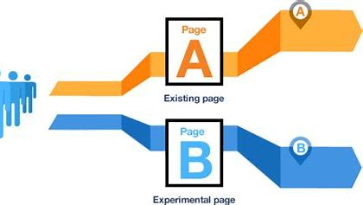
Data Analytics - Areas of Focus
Andrea Freire
Digital Transformation Leader
A/B Testing
Understanding the context in which customer were browsing the site/application/component.

Slide 14

Data Analytics - Areas of Focus
Andrea Freire
Digital Transformation Leader
Barriers
Limited knowledge of business
Limited Working relationships with managers in business units
Lack of motivation to answer questions to seek for accuracy and quickly
Processing and aggregating specific data
Constantly changing environment
Changing questions, challenges to find ways to answer new questions
Hard stop time constraints
Accelerated expected processes and outcomes
Use of analytics for validation (The use of analytics to validate decisions rather than answer questions)
Diminished drive for constant learning (sophistication of questions will increase over time)

Slide 15
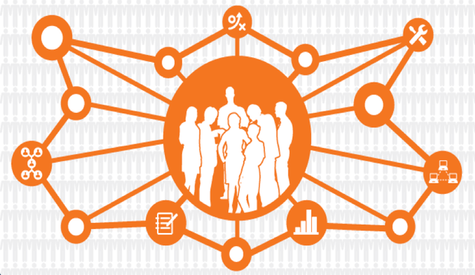
Data Analytics - Areas of Focus
Andrea Freire
Digital Transformation Leader
Data Democratization
Enables the ability to make critical decisions, quicker.
Access to data, the quicker and faster they will be to identify the organization’s needs.
Enables ownership and accountability over data.
Fosters and agile environment and entrepreneurial spirit.
Accountability starts to reside with the user of the data, its privacy and security.
Accessible data to all job functions outside executive, analysts and IT.
Opens the appetite for all employees to learn more about data.
Discover new insights.
diverse set of skills and experiences to uncover inefficiencies

Slide 16

Andrea Freire
Digital Transformation Leader
Summary
Reach out to business units in search of questions with the potential to generate value.
Establish equal partnership between various teams, data scientists, engineering, business units, business insight analysts. Foster a culture of entrepreneurship with the teams.
Develop or adopt system that will support the work of Business Insight analysts who are on the front lines engaging with data as it comes in, interpreting it, and working with managers, to develop novel ways of using data.
Implement hardware and software to bring machine learning and sophisticated analysis to data science projects.
Set agile development model, develop, test, measure, iterative approach to experimentation and to all engagements.
Have a rigorous focus on crafting testable, measurable metrics and a clear thought process about how a metric would facilitate action.
Communicate all approaches to partners within the business units.
Algorithms should be relevant and curated.

